Slide 1
Data Mining
Diabetic Databases
Are Rough Sets a Useful Addition?
Joseph L. Breault, MD, MS, MPH
joebreault@tulanealumni.net
Tulane University (ScD student)
Department of Health Systems Management
&
Alton Ochsner Medical Foundation
Department of Family Practice

Slide 2
Diabetic Databases
Diabetic databases have been used to
Query for diabetes,
As a comprehensive management tool to improve diabetic care and ommunications among professionals,
To provide continuous quality improvement in diabetes care.

Slide 3
The Veterans Administration (VA) developed their diabetic registry from an outpatient pharmacy database and matched social security numbers to add VA hospital admission data to it. They identified 139,646 veterans with diabetes.
The Belgian Diabetes Registry was created by required reporting of all incident cases of type 1 diabetes and their first degree relatives younger than 40. This has facilitated epidemiologic and genetic studies.
One British hospital linked their 7000 patient database to their National Health Services Central Registry to identify mortality data and found that diabetes was recorded in only 36% of death certificates, so analysis of death certificates alone gives poor information about mortality in diabetes.

Slide 4
Diabetes is a particularly opportune disease for data mining technology for a number of reasons.
Because the mountain of data is there.
Diabetes is a common disease that costs a great deal of money, and so has attracted managers and payers in the never ending quest for saving money and cost efficiency.
Diabetes is a disease that can produce terrible complications of blindness, kidney failure, amputation, and premature cardiovascular death, so physicians and regulators would like to know how to improve outcomes as much as possible.
Data mining might prove an ideal match in these circumstances

Slide 5
THE PIMA INDIAN
DIABETIC DATABASE
The Pima Indians may be genetically predisposed to diabetes, and it was noted that their diabetic rate was 19 times that of a typical town in Minnesota
The National Institute of Diabetes and Digestive and Kidney Diseases of the NIH originally owned the Pima Indian Diabetes Database
In 1990 it was received by the UC-Irvine Machine Learning Repository

Slide 6
The database has n=768 patients each with 9 numeric variables:
# of pregnancies,
2-hour OGTT glucose,
Diastolic blood pressure
Skin fold thickness
2-hour serum insulin
BMI
Diabetes pedigree
Age
Diabetes onset within 5 years
The goal is to predict #9. There are 500 non-diabetic patients and 268 diabetic ones for an incidence rate of 34.9%. Thus if you guess that all are non-diabetic, your accuracy rate is 65.1%. We expect a useful data mining or prediction tool to do much better than this.

Slide 7
PIDD Errors
5 had glucose = 0,
11 more had BMI = 0,
28 others had diastolic blood pressure = 0,
192 others had skinfold thickness readings = 0,
140 others had serum insulin levels = 0.
None of these are physically possible
392 cases with no missing values.
Studies that did not realize the previous zeros were in fact missing variables essentially used a rule of substituting zero for the missing variables.
Ages 21 to 81 and all are female.

Slide 8
STUDIES ON THE PIDD
The independent or target variable is diabetes status within 5 years, represented by the 9th variable (0,1).
Although articles use somewhat different subgroups of the PIDD, accuracy for predicting diabetic status ranges from 66% to 81%

Slide 9
ROUGH SETS IN MEDICAL DATA ANALYSIS
Rough sets investigate structural relationships in the data rather than probability distributions, and produce decision tables rather than trees.
This method forms equivalence classes within the training data, approximating it with a class below and a class above it.

Slide 10
A variety of algorithms can be used to define the classification boundaries.
Rough sets do feature reduction. Finding minimal subsets (reducts) of attributes that are efficient for rule making is a central part of its process
Rough sets have been applied to peritoneal lavage in pancreatitis, toxicity predictions, development of medical expert system rules, prediction of death in pneumonia, identification of patients with chest pain who do not need expensive additional cardiac testing, diagnosing congenital malformations, prediction of relapse in childhood leukemia, and to predict ambulation in people with spinal cord injury.
There are extensive reviews of their use in medicine. To our knowledge, there are no publications about their application to the PIDD.

Slide 11
Rough Sets in Diabetes
A recent study used a dataset of 107 children with diabetes from a Polish medical school.
Rough set techniques were applied and decision rules generated to predict microalbuminuria.
The best predictor was age < 7 predicting no microalbuminuria 83.3% of the times, followed by age 7-12 with disease duration 6-10 predicting microalbuminuria 80.8% of the times.

Slide 12
ROUGH SETS & THE PIDD
We randomly divided the 392 complete cases in the PIDD into a training set (n=300), and a test set (n=92). The ROSETTA software was downloaded from www.idi.ntnu.no/ ~aleks/rosetta/.

Slide 13
ROSETTA’s Steps
Deal with missing values in one of 5 ways, but we had removed these.
Discretization where each variable is divided into a limited number of value groups. There are 9 ways to do this and we chose the equal frequency binning criteria with k=5 bins.

Slide 14
Create reducts, which are subset vectors of attributes that facilitate rule generation with minimal subsets. This can be done by 8 methods; we choose the Johnson reducer algorithm. Rules are then generated.
Apply a classification method. We choose the batch classifier with the standard/tuned voting method. When the generated training rules are applied to the test set of 92 cases the predictive accuracy is 82.6%, which is better than all of the previous machine learning algorithms.

Slide 15

ROSETTA’s
Confusion Matrix
(1=diabetes, 0=no diabetes)

Slide 16
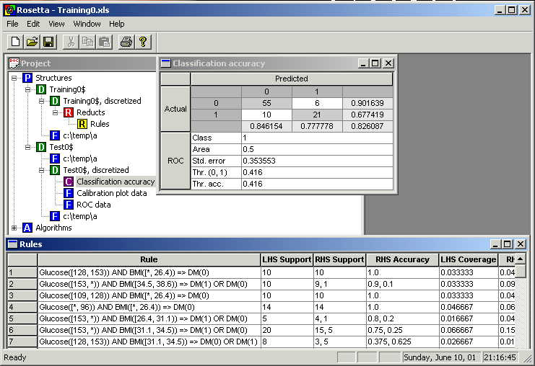

Slide 17
Domain Knowledge Unhelpful
When the discretization step was tweaked by domain knowledge (selecting 5 intervals for each variable based on being most clinically meaningful), results looked slightly improved on the training set (91.7% vs 91.0%), but were much worse on the test set (75.0% vs. 82.6%).

Slide 18
Discretization Method Choices
For the Johnson algorithm with tuned voting, accuracies were: Boolean 96%, entropy 78%, binning (k=5) 91%, naïve 100%, semi-naïve 99%, and BooleanRSES 90%.
We suspected that the ones in the high 90s are overfitted and would not do as well on the test set, thus binning might be a good choice.
Test results were Boolean 66%, entropy 62%, binning (k=5) 83%, naïve 67%, semi-naïve 78%, and BooleanRSES 74%.

Slide 19
Binning Number Choices
What binning number works best? On the training set using k=2, 3, 4, 5, 6 and 7 gives the following accuracies using the Johnson reduct with tuned voting: 81.3%, 90.3%, 87.3%, 91.0%, 91.3%, and 95%.
We suspect the highest binning numbers are heading toward overfitting. When the various binning numbers are used on the test set, we get accuracies of 76.1%, 79.3%, 81.5%, 82.6%, 78.3%, 81.5% indicating k=5 works best.

Slide 20
Obtaining a Mean & 95% CI
The 82.6% accuracy rate is surprisingly good, and exceeds the previously used machine learning algorithms that ranged from 66-81%.
Is this a quirk of the particular random sample that we obtained? 9 additional random samples were used, all with a training set of 300 and a test set of 92.
μ = 73.2% with a 95% CI of (69.2% - 77.2%)

Slide 21
Other Methods in ROSETTA
Using binning with k=5, reducts with the exhaustive calculation (RSES), we generate rules on the 10 training sets.
Then with the respective test sets, we classify them using the standard/tuned voting (RSES) with its defaults. The 10 accuracies ranged from 68.5% to 79.3% with a mean of 73.9% and a 95% CI of (71.5%, 76.3%).

Slide 22
CONCLUSIONS
Rough sets and the ROSETTA software are useful additions to the analysis of diabetic databases.
If time, ROSETTA demo
Questions? Discussion?

